Slide 1
Advanced JavaScript Session 3

Slide 2

Agenda
Objects
Inheritance
Polymorphism
Notes:
https://developer.mozilla.org/en/docs/Web/JavaScript/Reference/Global_Objects/Object/create

Slide 3
Objects in JavaScript
Notes:
https://developer.mozilla.org/en/docs/Web/JavaScript/Reference/Global_Objects/Object/create

Slide 4
Objects creation
Using an Object Literal
Using the JavaScript Keyword new
var person = {firstName:"John", lastName:"Doe", age:50, eyeColor:"blue"};
var person = new Object(); person.firstName = "John"; person.lastName = "Doe"; person.age = 50; person.eyeColor = "blue";

Slide 5
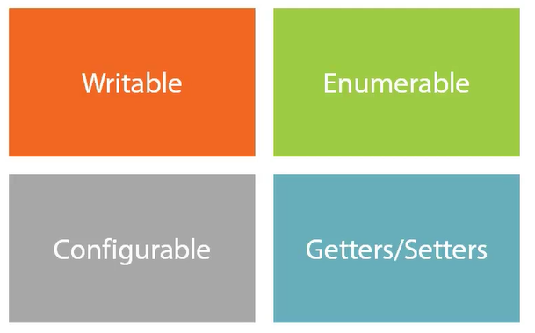
Object Properties

Slide 6
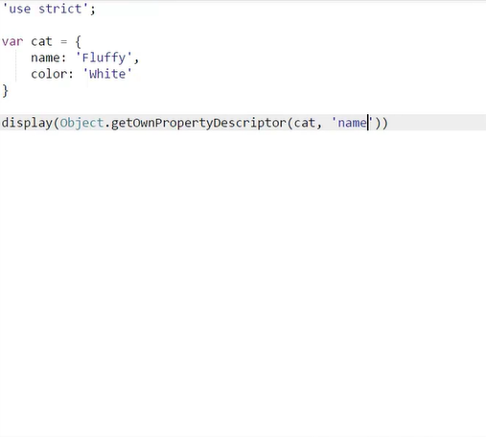
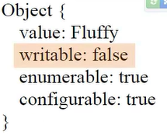

Object Properties -Writable
Error

Slide 7
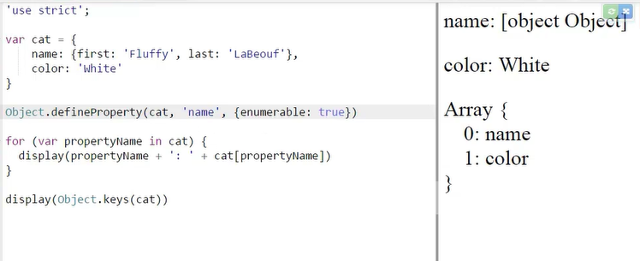
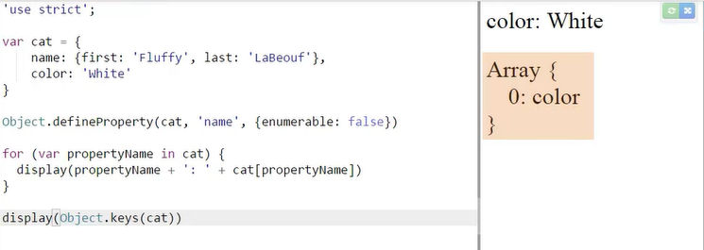
Enumerable

Slide 8
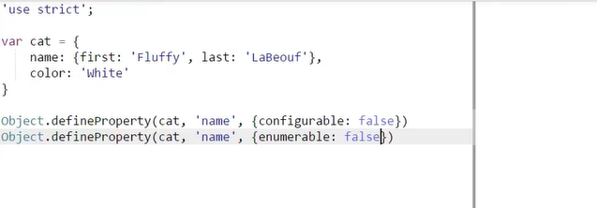

Configurable

Slide 9
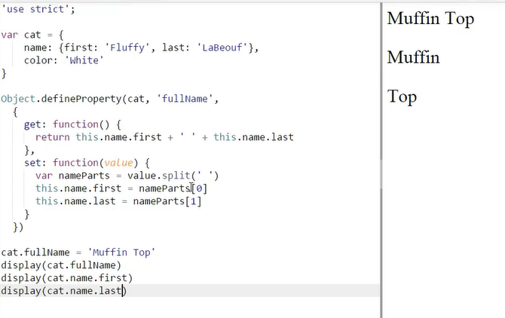
Getters/Setters

Slide 10
THANK YOU!!!

